Slide 1


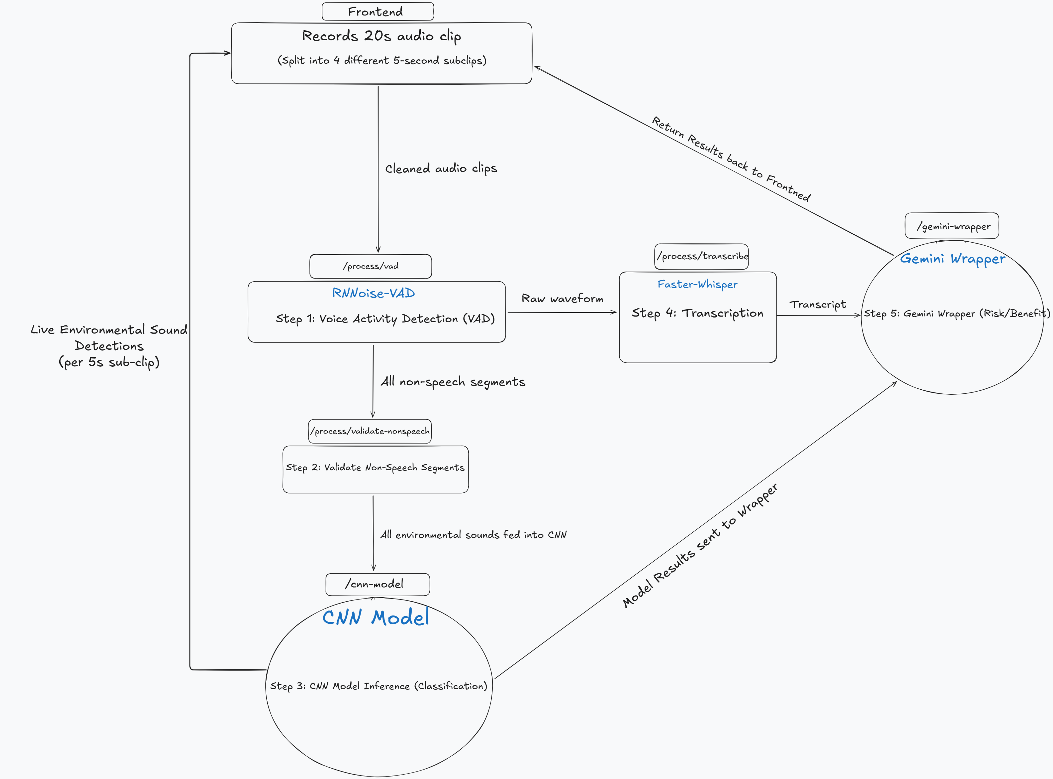





School of Computing & Information Sciences
Fall 2025 Senior Design Project
EchoGuard
Students: Abner Rodriguez (Team Leader), Kevin Sanchez, Carlos Navarro, Kenneth Martin, Alfonso Contreras
Instructor/Faculty: Dr. Masoud Sadjadi, Florida International University
PROBLEM
SOLUTION
REQUIREMENTS
Children today are increasingly exposed to digital media where audio content can be unpredictable.
However,
1. Many environments struggle to provide awareness and context about the media children are consuming.
Harmful sounds such as gunshots, explosions, or shouting can easily go unnoticed.
Parents often cannot monitor audio in real time, especially during multitasking or remote learning.
2. Speech Content can be difficult to interpret.
Conversations may contain inappropriate topics, sensitive themes, or unsafe interactions.
Younger children may not understand concerning language, leaving parents unaware.
3. Evaluating audio safety is limited and inconsistent.
Manual monitoring is unreliable and impractical.
Existing parental control tools focus on visual content, ignoring environmental sound risks.
EchoGuard Is Our Solution.
EchoGuard provides parents with:
Real-time detection of environmental sounds such as gunshots, crying, and shouting.
Gemini-generated risk and benefit scores that summarize overall safety.
A unified platform that analyzes both non-speech sounds and spoken language for a complete understanding of audio environments.
EchoGuard was created with the goal of giving families an accessible way to evaluate the safety of audio content.
By combining sound classification, speech transcription, and AI-driven reasoning, it bridges the gap between raw audio and meaningful safety insights.
To ensure that EchoGuard fulfills its intended purpose, it follows these requirements for its design and implementation:
The application must be easy to access, navigate, and use for parents and non-technical users.
Audio clips must be processed reliably through each stage of the pipeline (VAD, validation, CNN, transcription, Gemini).
The system must provide clear and understandable safety insights, even for users unfamiliar with technical audio analysis.
The interface must remain non-intrusive, offering live feedback without overwhelming the user.
BACKEND/SYSTEM DESIGN
EchoGuard’s backend is organized into modules, each responsible for a single stage of analysis:
Voice Activity Detection, Non-speech Validation, CNN Sound Classification, Transcription, Gemini Risk/Benefit Score Generation.
The system supports real-time environmental sound detection while simultaneously preparing the full recording for transcription and risk/benefit evaluation. Below is an outline of EchoGuard’s system design:
IMPLEMENTATION
EchoGuard is powered by a Flask backend and a Next.js frontend that work together to analyze audio in 5-second intervals.
The system integrates multiple components including RNNoise VAD, a custom environmental sound CNN, Faster-Whisper for transcription, and Google’s Gemini 2.5 Pro Model. All backend processing is executed on-demand to ensure low latency.
In future builds, EchoGuard will expand its environmental sound library, and will also integrate with Supabase database.
VERIFICATION
FUTURE PLANS
SUMMARY
Before any release, EchoGuard will undergo verification to ensure accuracy, reliability, and consistent behavior across different use cases.
To verify, the application will undergo:
Review by a Psychology Professor to validate safety scoring, content interpretation, and rubric design.
Testing by users with varying levels of technical experience to ensure accessibility and ease of use.
Testing across different browsers, devices, and audio environments to confirm stable performance.
Testing of login features and data persistence once Supabase integration is implemented.
EchoGuard currently supports real-time environmental sound detection and Gemini-generated risk/benefit scores. Moving forward, the platform aims to expand its sound classification library.
Future versions will also integrate a Supabase database, allowing user settings, past analyses, and safety results to persist across sessions. Additional enhancements will focus on refining the scoring rubric and extending EchoGuard’s capabilities to handle a broader range of audio environments.
In conclusion, EchoGuard provides families clear insight into what media their children may be consuming. It brings together sound classification, transcription, and AI-driven analysis into one accessible platform.
While no system can fully replace direct parental supervision, EchoGuard offers meaningful support by identifying potentially harmful audio cues and summarizing speech content in a clear, understandable way. It is designed to help families better navigate today’s media-heavy environments.
ACKNOWLEDGEMENT
Special thanks to Christian Poellabauer, our Project Manager at FIU for aiding us with the implementation of EchoGuard. Without him and
his passion for this project, the concept of this project would have never come to life.

